Slide 1
OSSS
(Open Source Security & Surveillance)
-or-
How to Create your own Internet-accessible
Recording Motion Detecting Camera (and
Have fun doing it!)
Donald Burr
<dburr@vctlabs.com>
http://vctlabs.com/
http://DonaldBurr.com/
ScaLE 13x (2015) - UpSCaLE

Slide 2


The problem to be solved

Slide 3
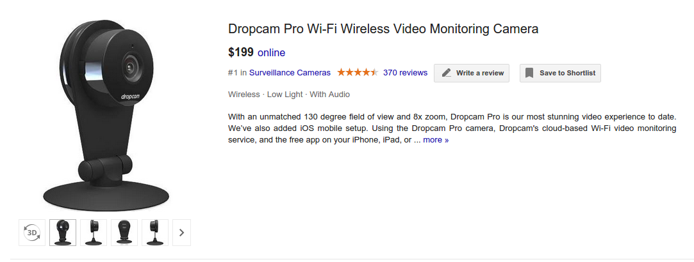


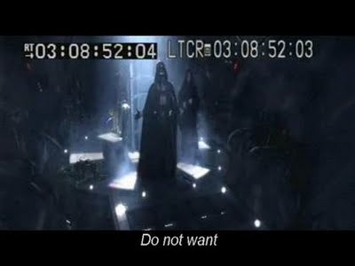
+
+
=

Slide 4
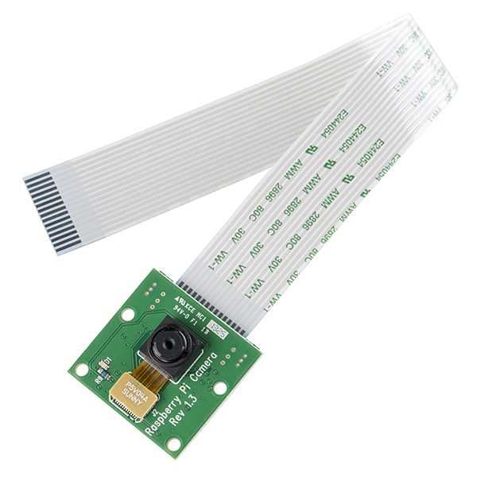
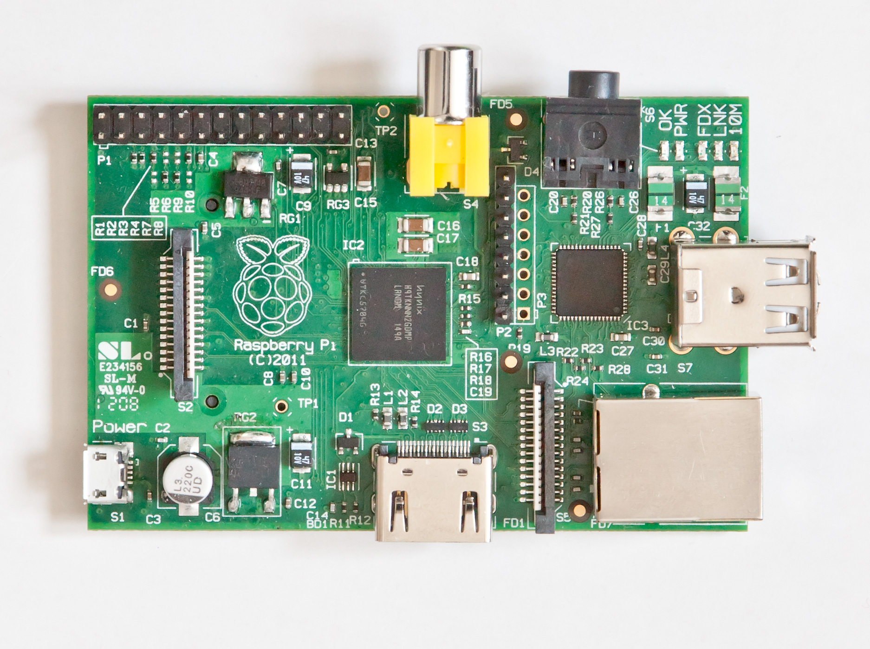



+
+
=

Slide 5
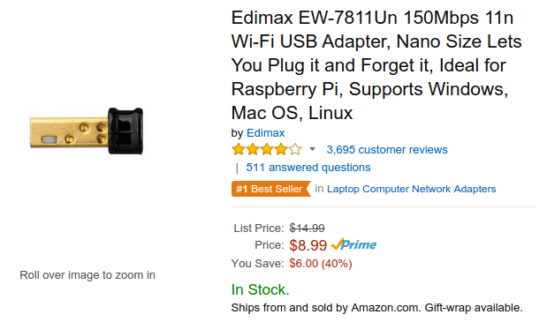
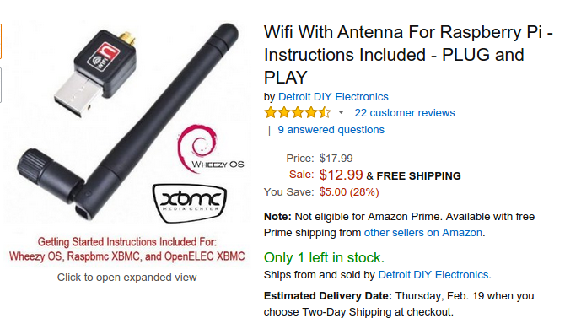
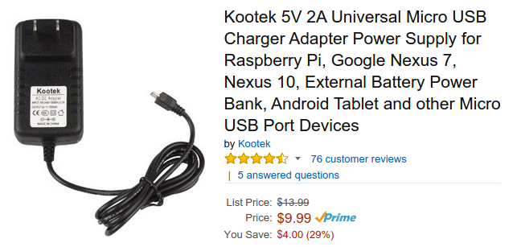

Slide 6
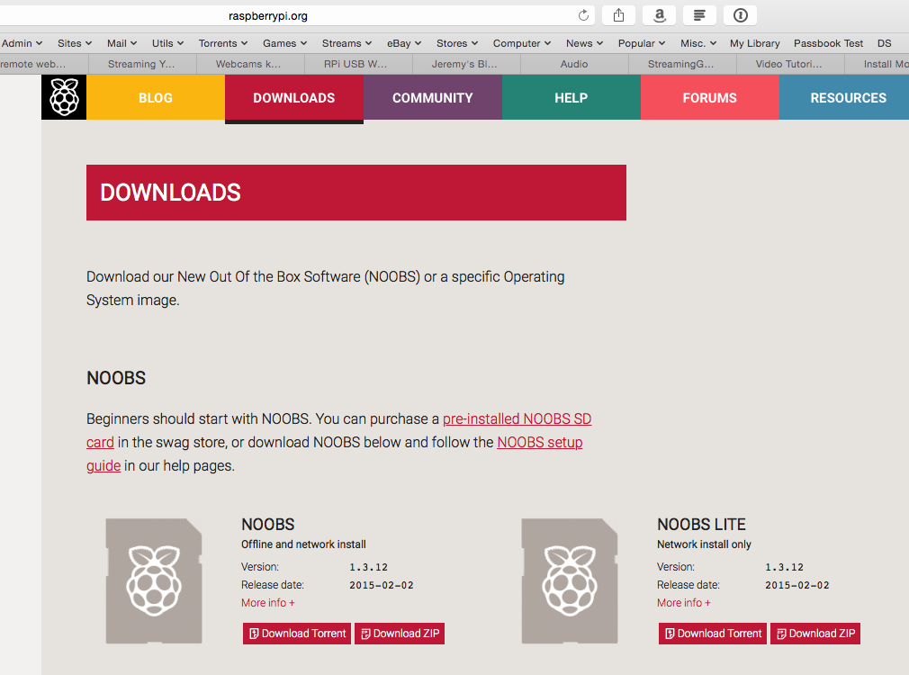
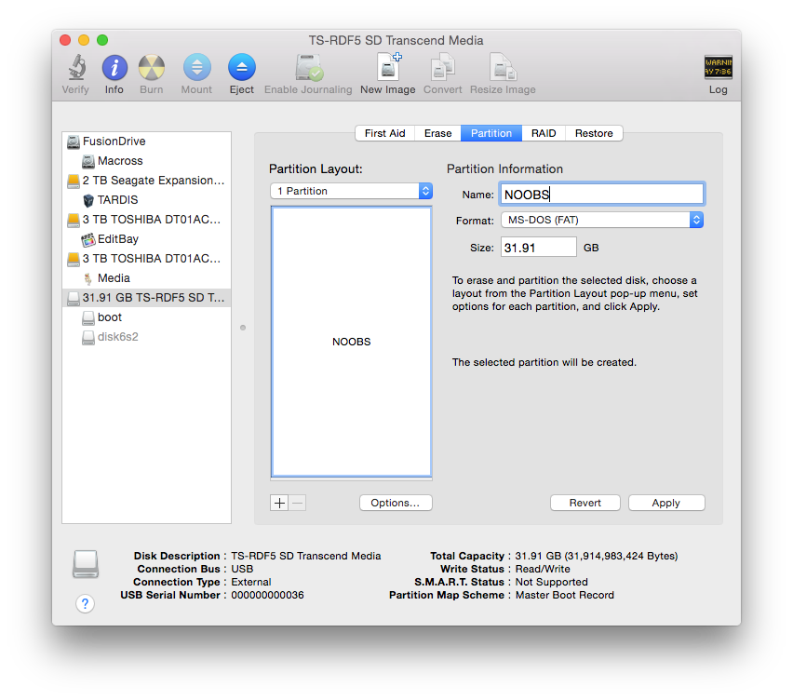
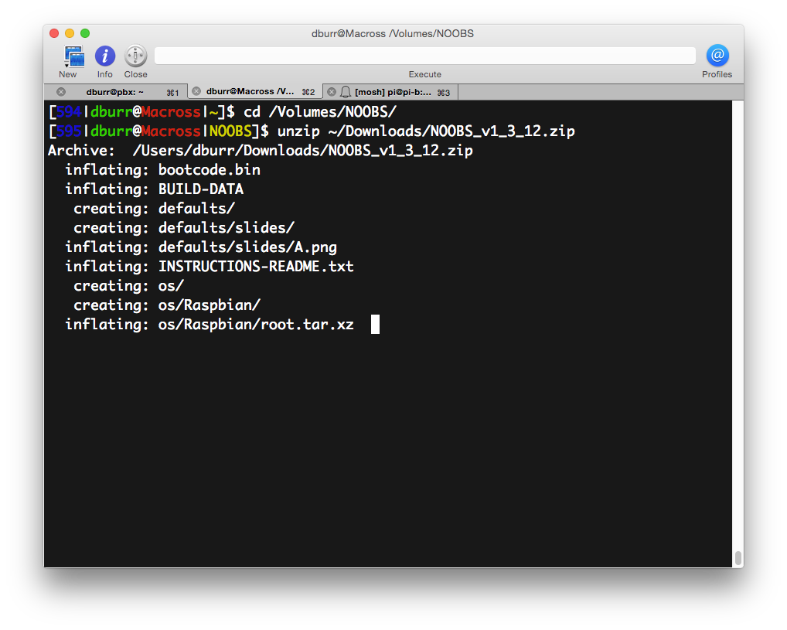
STEP 0

Slide 7
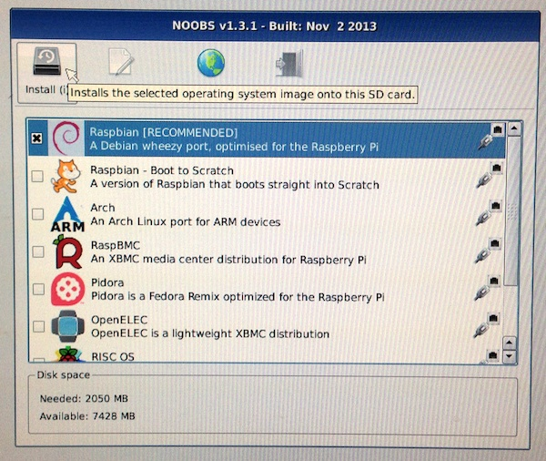
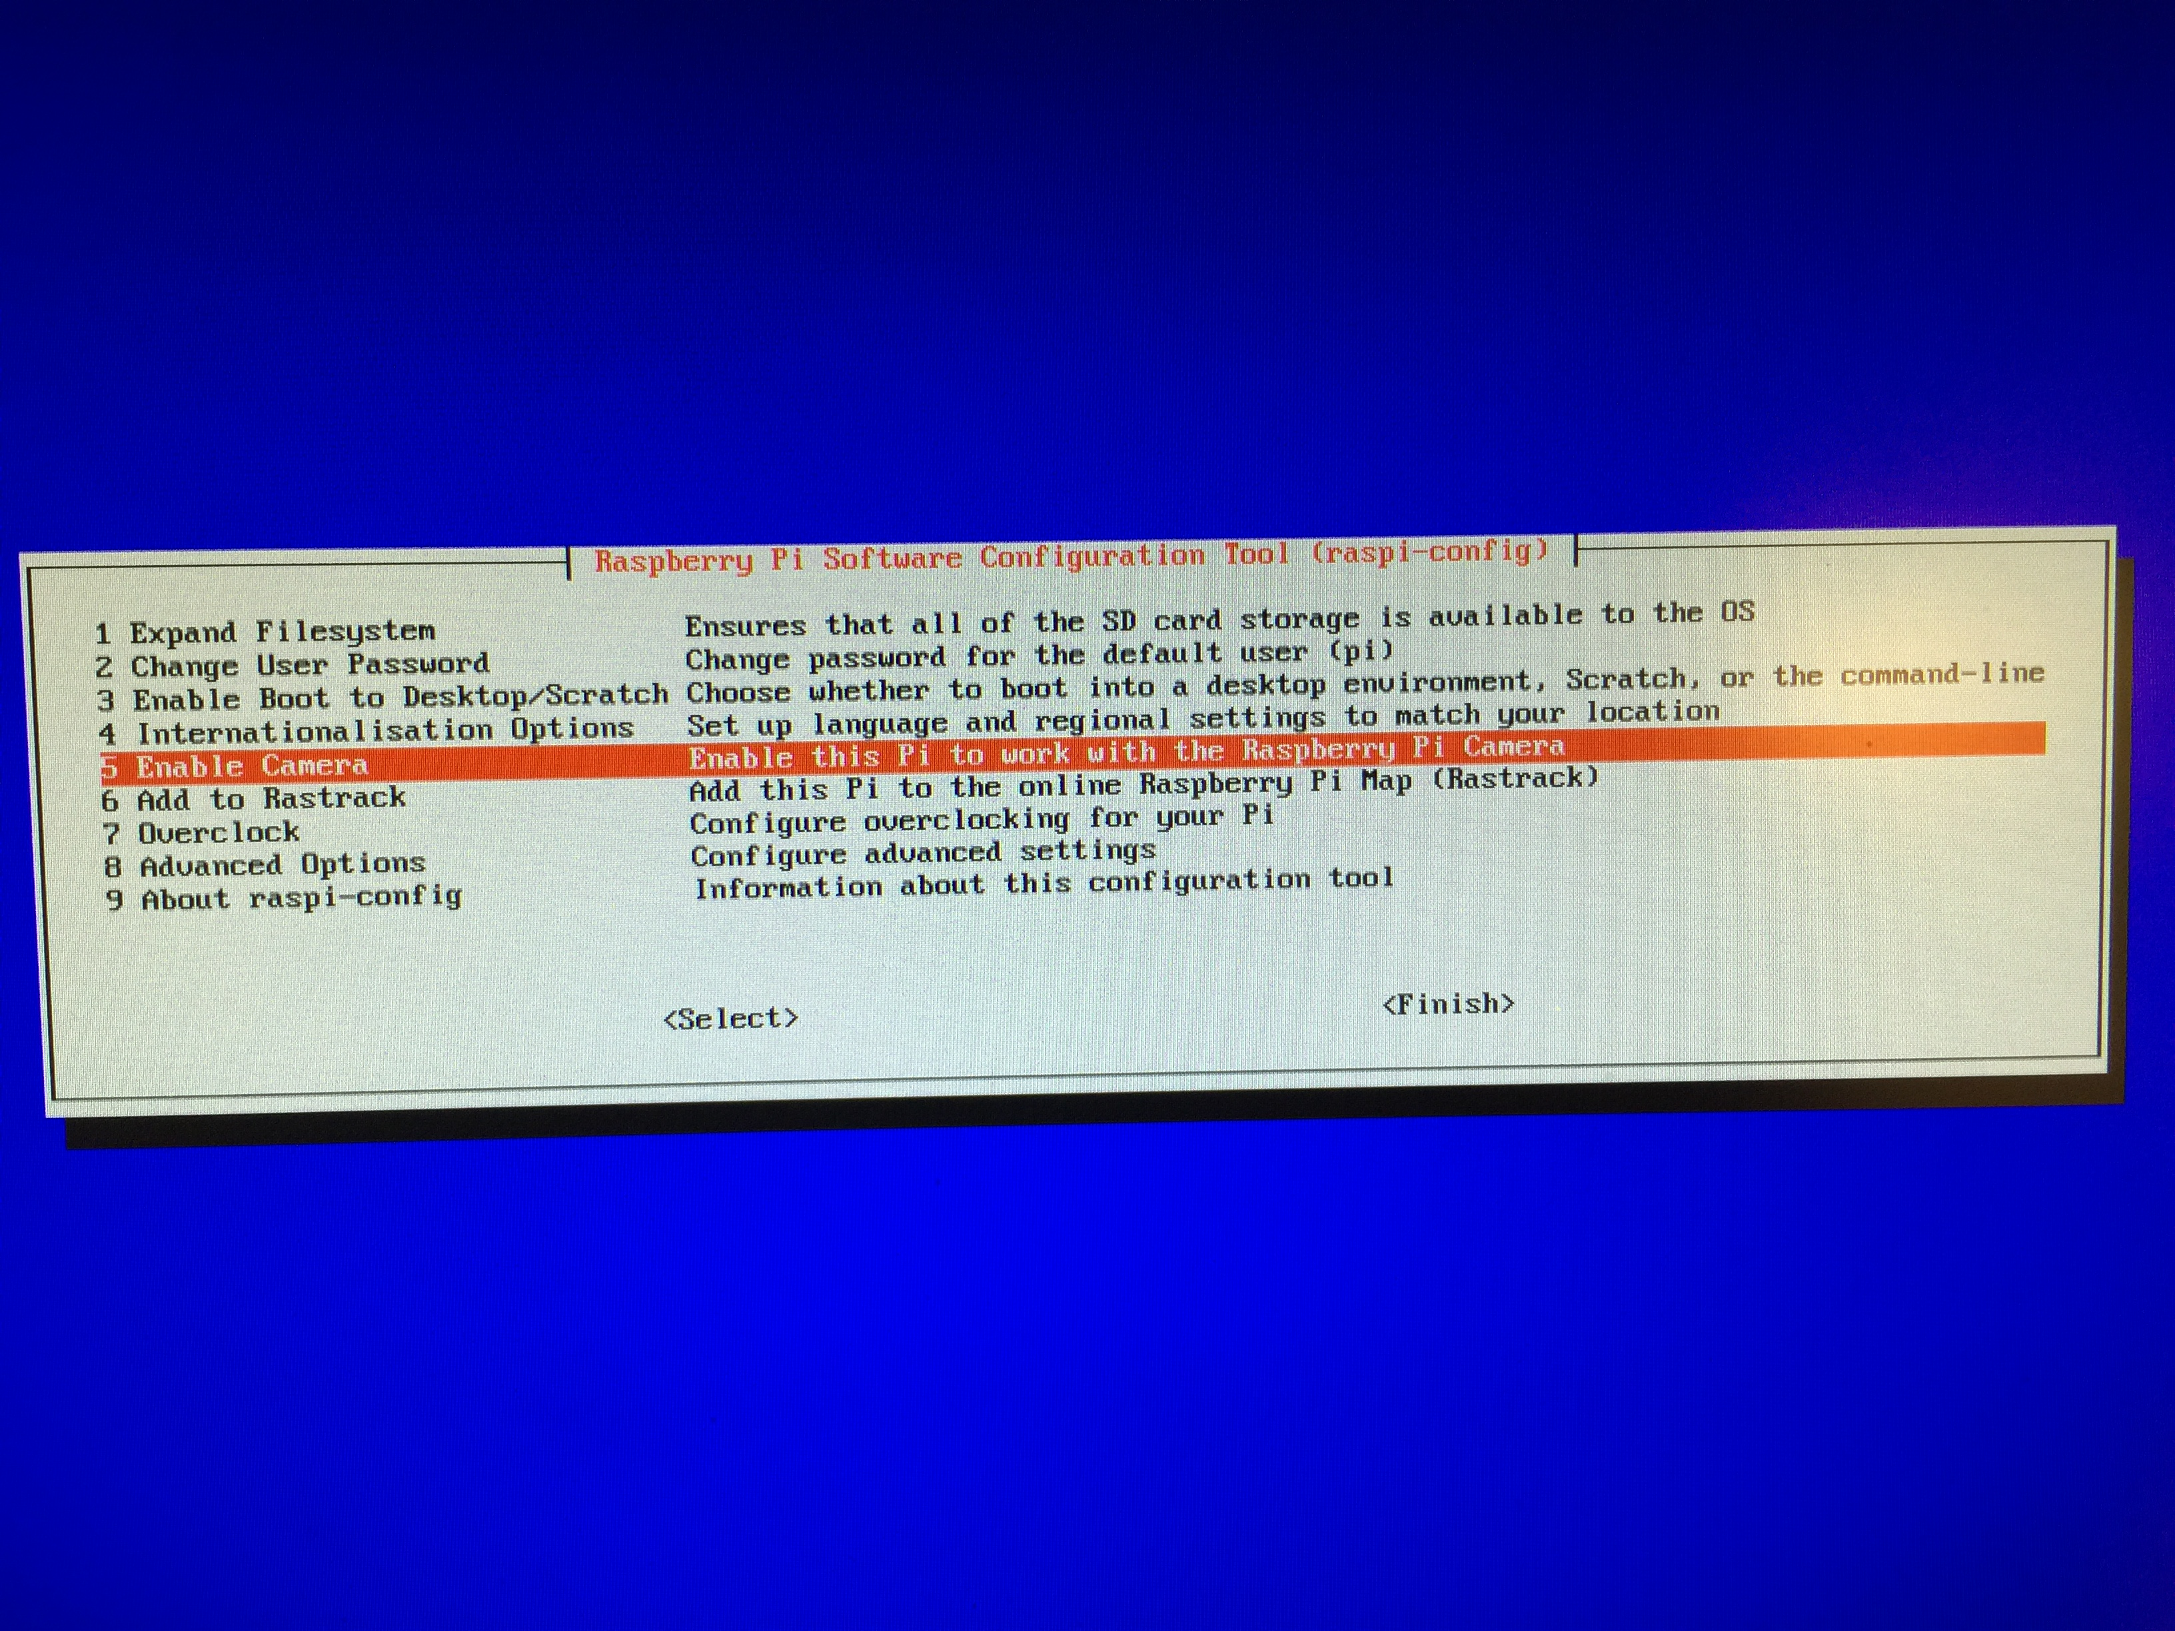
STEP 1
(sudo raspi-config)

Slide 8
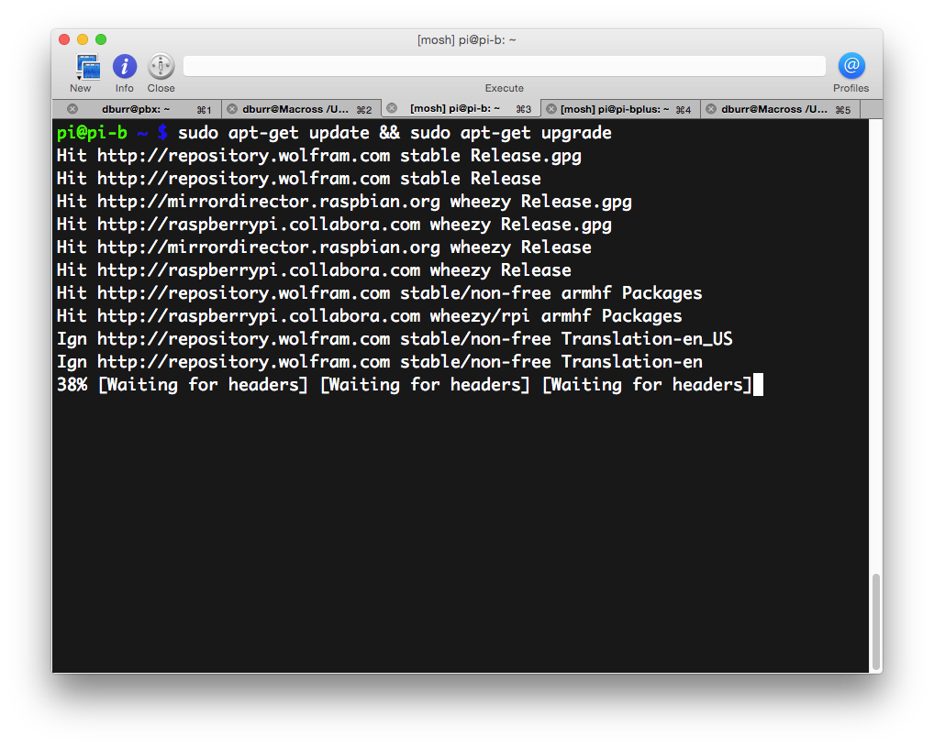
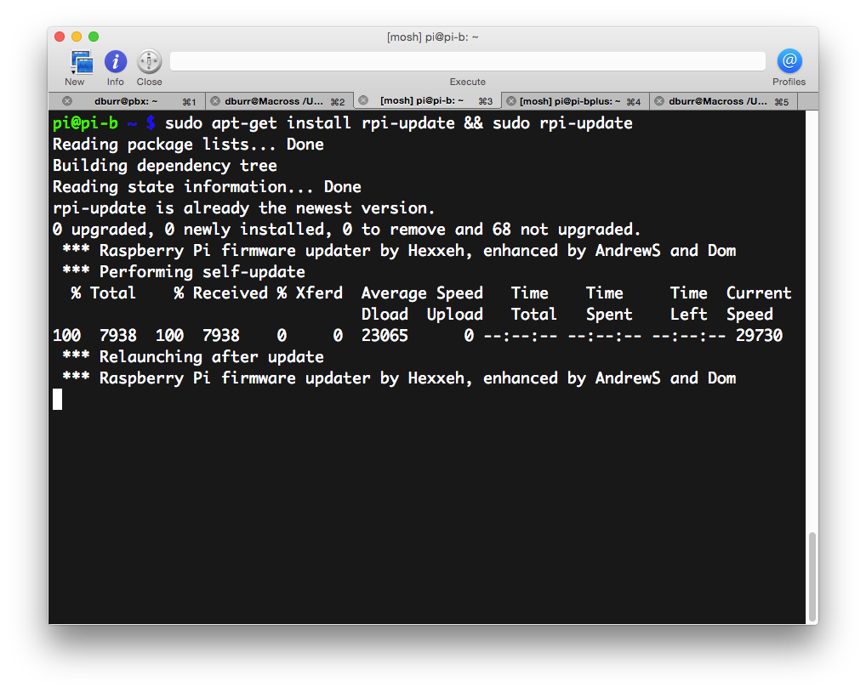
STEP 2

Slide 9

STEP 3
(what kitteh is really saying is: DON'T install motion-mmal.
Just “sudo apt-get install motion”)

Slide 10
STEP 4
sudo nano /etc/modules
(add “bcm2835-v4l2” to the end of the file)
sudo modprobe bcm2835-v4l2
sudo nano /etc/motion/motion.conf
LET THE TWEAKING BEGIN!!!!!!!11

Slide 11
Things You Can Tweak
logfile – where to save the logs (useful for
debugging)
width, height, framerate – 320x240, 30 fps
(you can try playing around with these)
pre_capture, post_capture – frames to keep
before/after capture (keep them small)

Slide 12
More tweakables
ffmpeg_video_codec (msmpeg4)
locate = draw a box around motion
locate_motion_style (box, redbox, cross,
redcross)

Slide 13
Yes! More tweakables!
text_left and text_right
target_dir (where to save to)

Slide 14
Tuning the detection algorithm
threshold (# of changed pixels)
threshold_tune
noise_level
noise_tune (leave this on)
lightswitch

Slide 15
Still more tweakables!
webcam_port
webcam_maxrate (doesnt do much)
webcam_localhost

Slide 16
STEP 5
sudo nano /etc/default/motion
(set start_motion_daemon = yes)
sudo service motion start

Slide 17
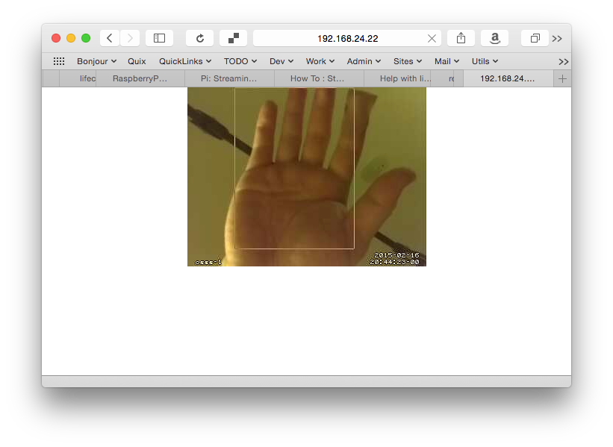
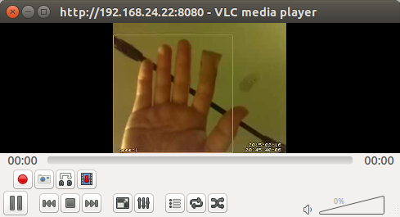
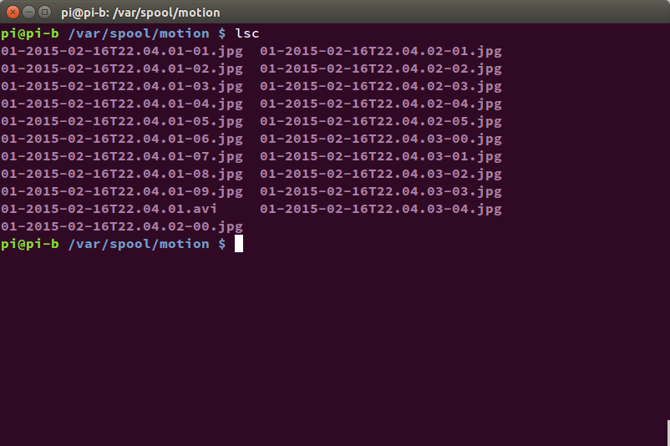
Browse to http://IP-OF-PI:PORT/
...or use VLC
(Media → Open Network Stream)
Review saved photos / videos
(use vlc, eog, etc. to look at 'em)

Slide 18
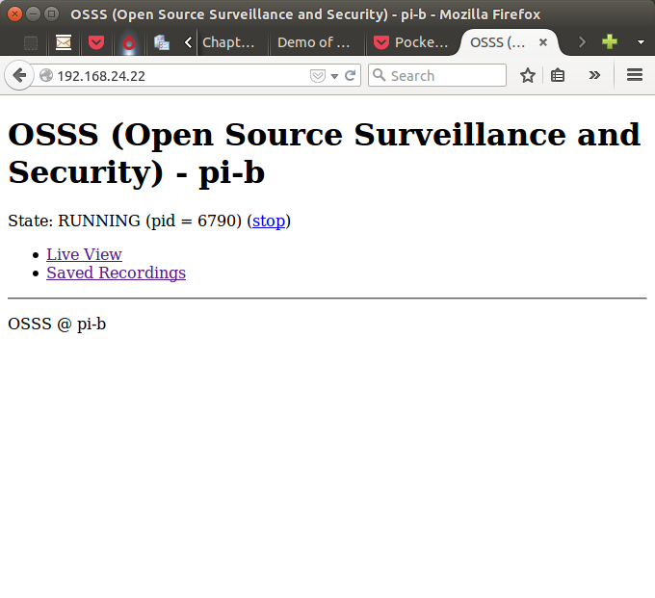
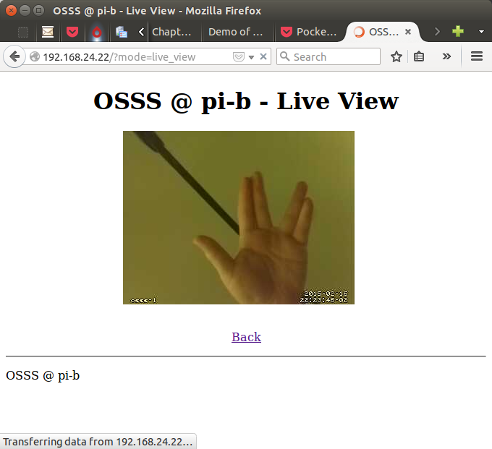
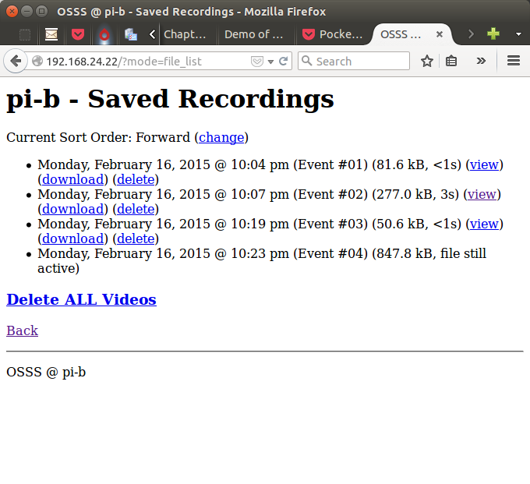
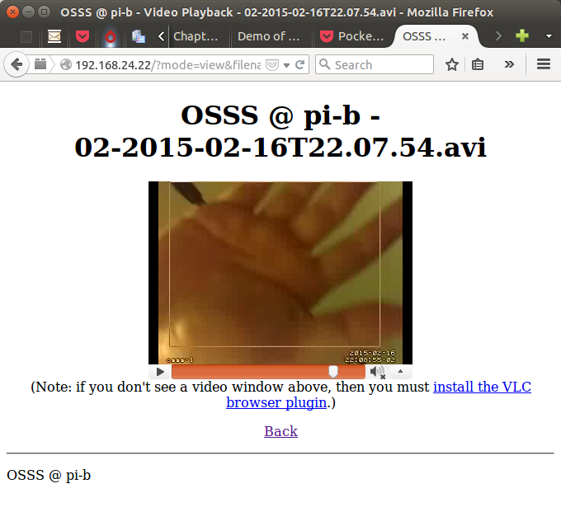
Let's Add a Web UI!

Slide 19



Simply compile & install!
...Or you could let me do
(most of) the work for you!
git clone https://github.com/dburr/OSSS.git
cd OSSS
sudo bash install.sh
Pull requests welcome!

Slide 20

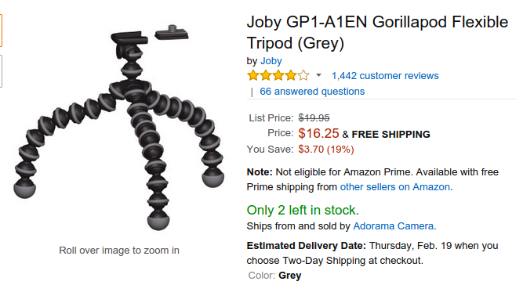
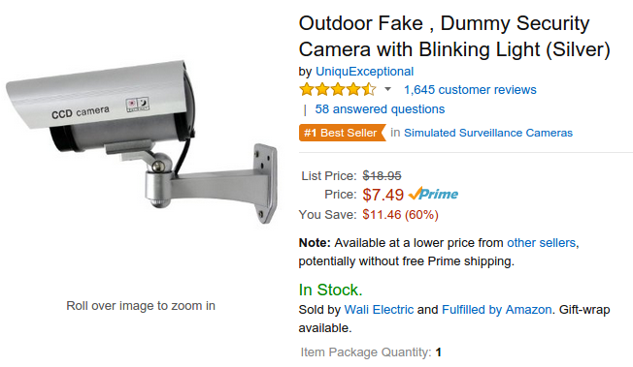
Put It In a Case & Mount It!

Slide 21
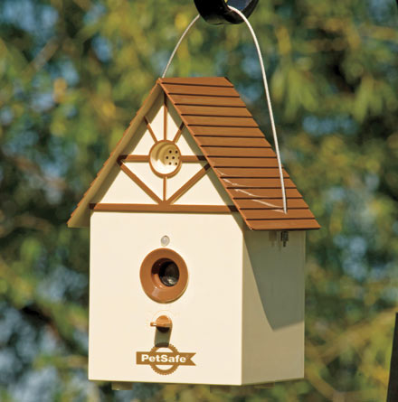

...Or Take the Stealthy Approach
(you might want to hide the LED though...)
sudo nano /boot/config.txt, add “disable_camera_led=1”)
SHARE & ENJOY!

